Slide 1
Ideation – What is Innovation?
A new idea is a novel combination
of existing ideas.

Slide 2
Walkman + Pendrive =
(1979)
(2000)
?

Slide 3
Walkman + Pendrive =
(1979)
(2000)
iPod
(2001)

Slide 4
Book + Computer=
(2000 BC) (1940s)
?

Slide 5
Book + Computer=
(2000 BC) (1940s)
iPad
(2010)

Slide 6
Encyclopedia + CD =
(1700 ) (1982)
?

Slide 7
Encyclopedia + CD =
(1700 ) (1982)
Microsoft Encarta
(1995)

Slide 8
Encyclopedia + Website=
(1700 ) (1992)
?

Slide 9
Encyclopedia + Website=
(1700 ) (1992)
Wikipedia
(2001)

Slide 10
Car + Boat + Fish=
(1880s ) (Early Man) (Before man came)
?
Yash Saxena, Apr 2013

Slide 11
Car + Boat + Fish=
(1880s ) (Early Man) (Before man came)
Submarine
(1890s)

Slide 12
Car + Kitchen =
(1880s ) (Early Man)
?

Slide 13
Car + Kitchen =
(1880s ) (Early Man)
Restaurant on the Wheels
(1890s)

Slide 14
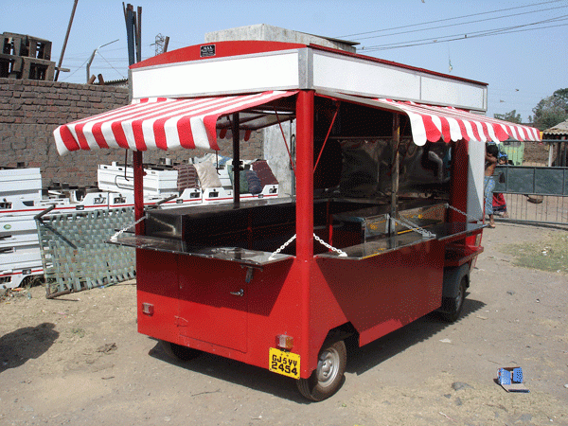

Slide 15
Yash Saxena, Apr 2013

Slide 16
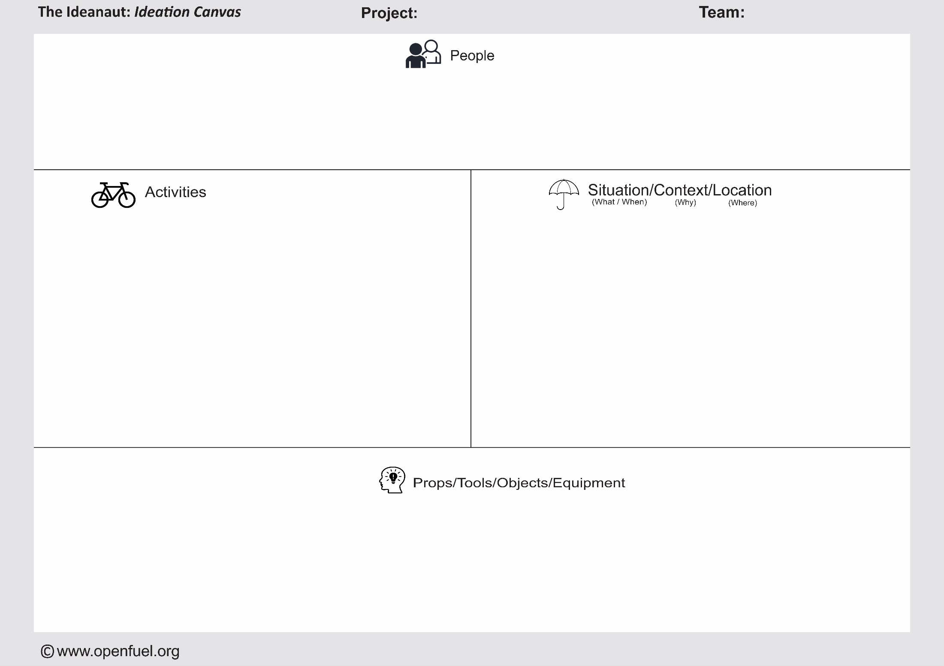
Problem Zone
Possible Solutions

Slide 17
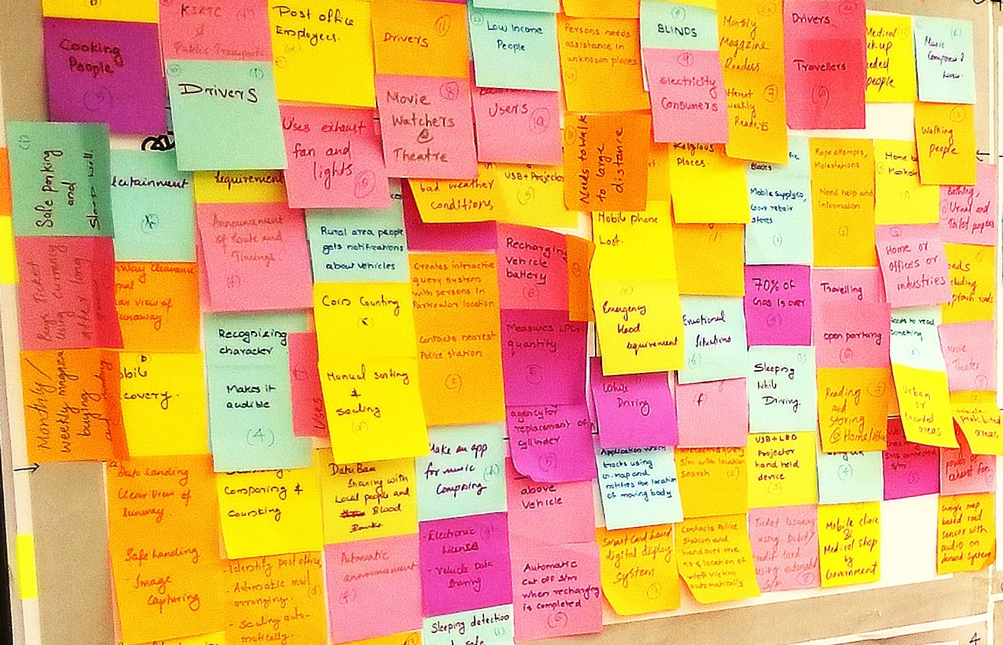
Ideation Canvas:

Slide 18
Thank you

